Slide 1
ADVANCED DATA ANALYTICS FINAL PROJECT
Tourism Consumer Behaviour Analytics
Customer Segmentation & Spending Prediction from Tourism Consumer Behavior Data
2,456
4
90.4%
Customer Records
Customer Segments
Spending Prediction R²

Slide 2
AGENDA
What We'll Cover
01
Business Objective & Dataset
02
Data Quality & Exploration
Why this analysis matters, and what data powers it
Cleaning checks and the patterns hiding in the numbers
03
Customer Segmentation
04
Spending Prediction
Grouping travelers with K-Means clustering
Comparing six regression models
05
Interactive Dashboard
06
Recommendations
Bringing insights to Power BI
Turning findings into business action
02

Slide 3
PROJECT OVERVIEW
Business Objective & Dataset
Dataset Snapshot
Objective
Understand what drives tourism spending, group customers into meaningful segments, and predict how much a customer will spend — so marketing and pricing decisions can be targeted rather than guessed.
2,456
10
Customer records
Features tracked
0
0
Guiding Questions
What customer behaviors correlate most with spending?
Missing values
Duplicate rows
Are there natural customer segments in the data?
Tracked Features
Age • Gender • Income Level • Preferred Travel Type • Avg Trip Duration • Spending Amount • Booking Channel • Repeat Visitor • Customer Review Score
Can spending be predicted from customer profile data?
03

Slide 4
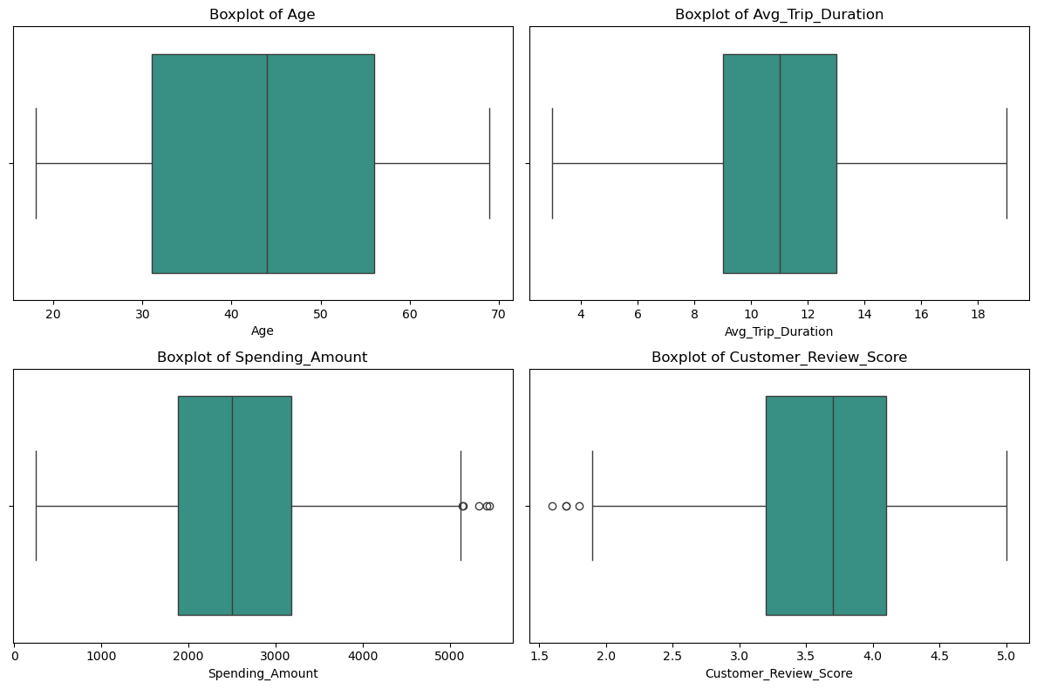
DATA PREPARATION
Data Quality & Outlier Check
Key Findings
Zero missing values and zero duplicate records across all 2,456 rows
IQR analysis shows virtually no outliers in Age or Trip Duration
5 high-spending VIP customers exceed $5,130 in spend
4 customers left critically low review scores, below 1.8
Outliers reflect real extreme behavior, not data errors — dataset is stable and ready for analysis
04

Slide 5
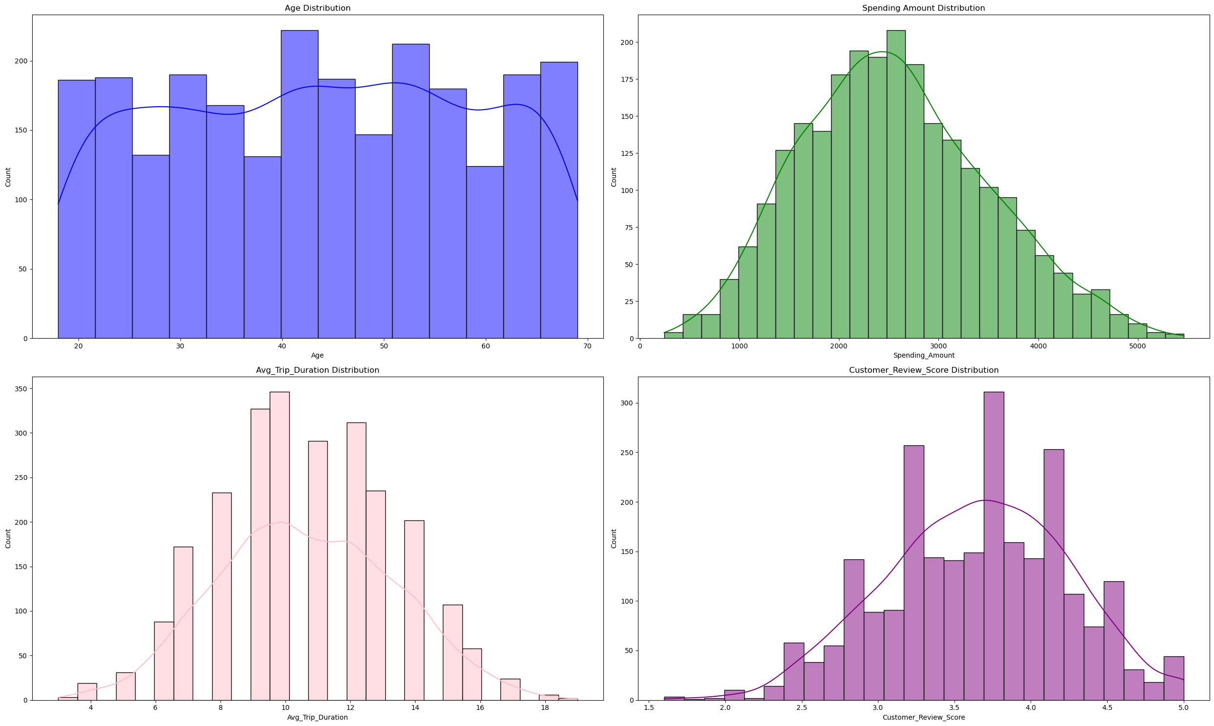
EXPLORATORY DATA ANALYSIS
How Are Customers Distributed?
Reading the Distributions
Age is spread evenly from 18 to 69 — no single generation dominates
Spending follows a near-normal curve centered around $2,500
Trips average about 11 days, clustering between 9–13 days
Review scores concentrate between 3.5 and 4.5 — customers are broadly satisfied
05

Slide 6
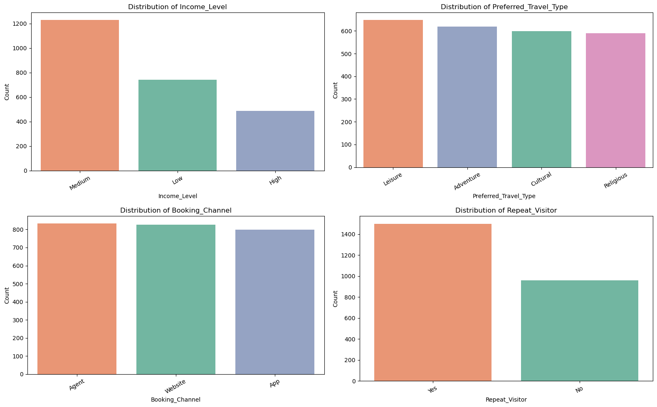
EXPLORATORY DATA ANALYSIS
Who Are Our Customers?
Profile Highlights
Medium income travelers are the largest group, ahead of Low and High income
Preference spreads across Cultural, Leisure, Adventure and Religious trips
Booking is fairly balanced across Website, Agent and App channels
Repeat visitors make up a meaningful share of the customer base
06

Slide 7
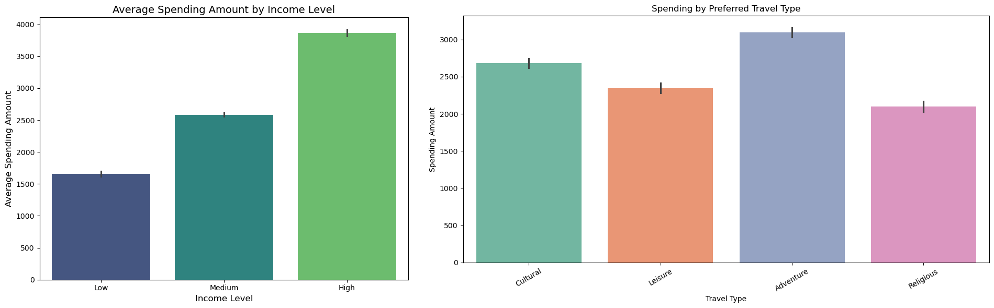
EXPLORATORY DATA ANALYSIS
What Drives Spending?
Income Level
Travel Type
High-income travelers spend ~$3,860 on average vs. ~$1,650 for low-income — a clear, strong relationship.
Adventure trips generate the highest average spend (~$3,100); religious trips are the shortest and least expensive.
07

Slide 8
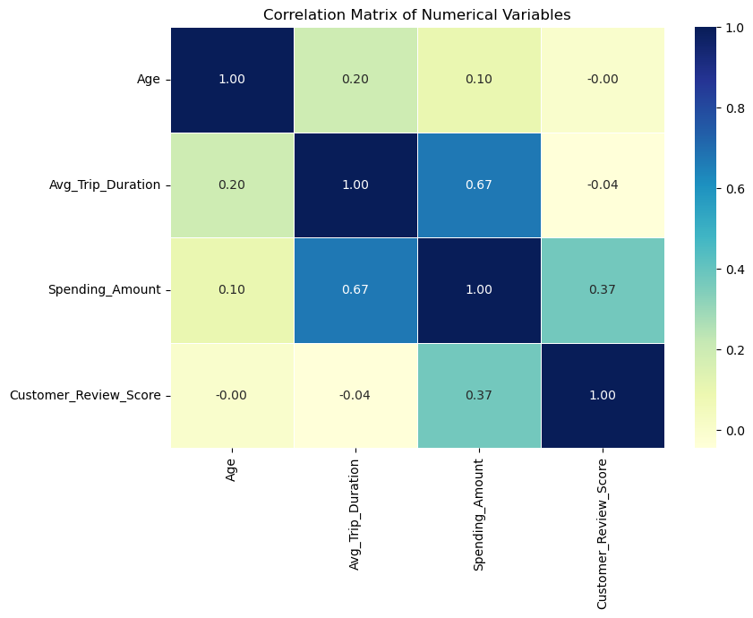
EXPLORATORY DATA ANALYSIS
Correlation Analysis
What the Numbers Say
r ≈ 0.67
Trip Duration ↔ Spending Amount
A strong positive correlation: longer trips reliably mean higher spending.
r ≈ 0.09
Age ↔ Spending Amount
Virtually no relationship — purchasing power is evenly spread across age groups.
08

Slide 9
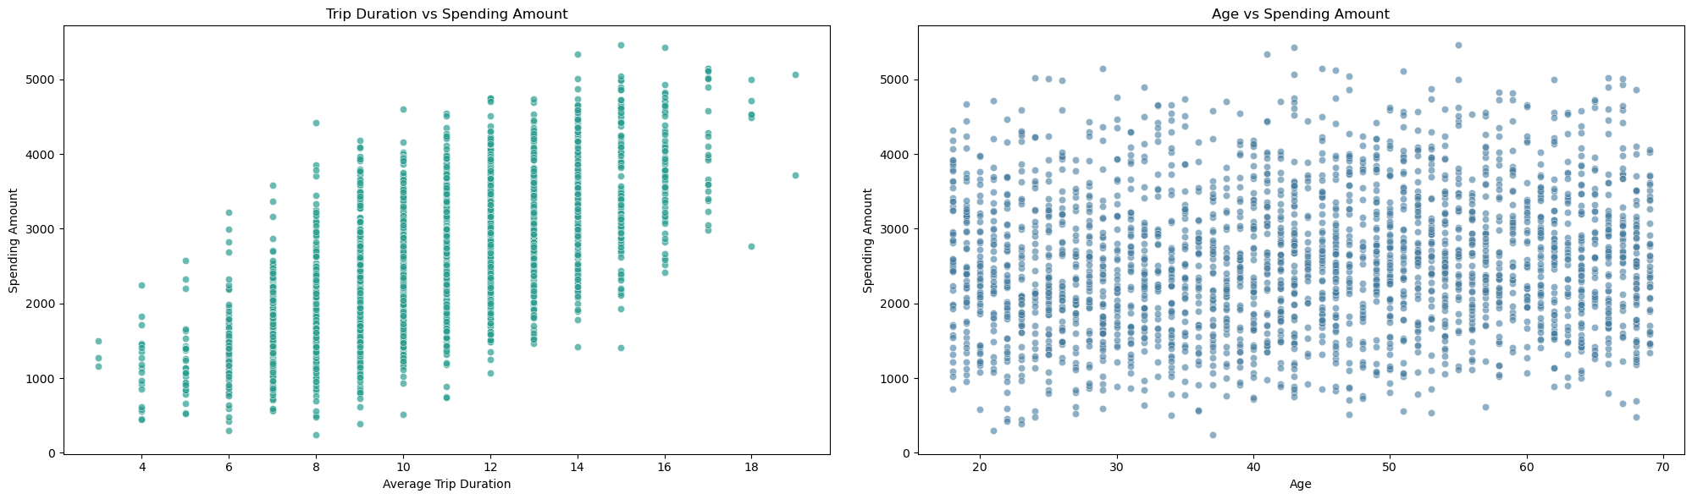
EXPLORATORY DATA ANALYSIS
From Insight to Business Value
Extend the Stay
Don't Age-Target Premium
Since trip duration drives spending, promote offers like “book 7 days, get the 8th at 50% off” rather than upselling pricier day packages.
A 25-year-old is statistically as likely to buy a $5,000 package as a 60-year-old — target by behavior, not age.
09

Slide 10
CUSTOMER SEGMENTATION
Choosing the Right Number of Segments
Numeric features (Age, Trip Duration, Spending, Review Score) were scaled and clustered with K-Means, testing K = 2 through 8.
Elbow Method — Inertia by K
Silhouette Score by K
Davies-Bouldin Index by K
10

Slide 11
CUSTOMER SEGMENTATION
Four Distinct Customer Segments
K = 4 selected — the clearest, most actionable balance of cohesion and business interpretability.
High-Value Adventure Travelers
Budget Occasional Travelers
Satisfied Leisure & Religious Travelers
Loyal Mature Travelers
28.6%
21.6%
23.3%
26.5%
702 customers
530 customers
573 customers
651 customers
Avg. Spending
Avg. Spending
Avg. Spending
Avg. Spending
$3,620
$1,782
$2,313
$2,262
Avg. Age
Avg. Age
Avg. Age
Avg. Age
46.4 yrs
32.1 yrs
34.1 yrs
58.8 yrs
Review Score
Review Score
Review Score
Review Score
3.91
3.04
4.13
3.43
11

Slide 12
CUSTOMER SEGMENTATION
What Sets Each Segment Apart
Average Spending by Segment ($)
Repeat Visitor Rate by Segment (%)
12

Slide 13
SPENDING PREDICTION
Predicting Spending: Model Comparison
Six regression models were trained to predict Spending Amount from customer profile features, evaluated on held-out test data and 5-fold cross-validation.
Test R² by Model
Best Model
Linear Regression
0.904
$233.9
$296.2
R²
MAE
RMSE
Simple linear models match or beat complex ones (Random Forest, Gradient Boosting, SVR) — spending is driven by additive, largely linear effects, not hidden non-linear interactions.
13

Slide 14
SPENDING PREDICTION
What Predicts Customer Spending?
1
2
3
Income Level
Avg. Trip Duration
Booking Channel & Repeat Visitor
Higher income tiers show substantially higher average spending — the single strongest driver.
Longer trips are consistently associated with higher total spending.
Secondary, smaller positive effects on spending patterns.
Model Performance Summary
R² = 0.904
MAE ≈ $234
Std ≈ 0.002–0.004
The model explains ~90% of the variance in customer spending
Average prediction error is small relative to the ~$100–$6,000 spending range
Low cross-validation variance — a robust, generalizable model
14

Slide 15
INTERACTIVE REPORTING
Bringing It Together in Power BI
A four-page interactive dashboard lets stakeholders explore segments, spending and model results without touching code.
1
2
3
4
Customer Overview
Spending & ML
Dashboard 1
Dashboard 2
Customer Segments Distribution
Average Spending by Income Level
Segment KPIs & filters
Spending by booking channel & income
Spending by Segment
Average Spending by Booking Channel
Spending and travel-preference visuals
Model performance comparison
Travel Preference by Segment
Model Performance Comparison
Interactive slicers by segment
Summary KPI cards
Repeat Visitors
15

Slide 16
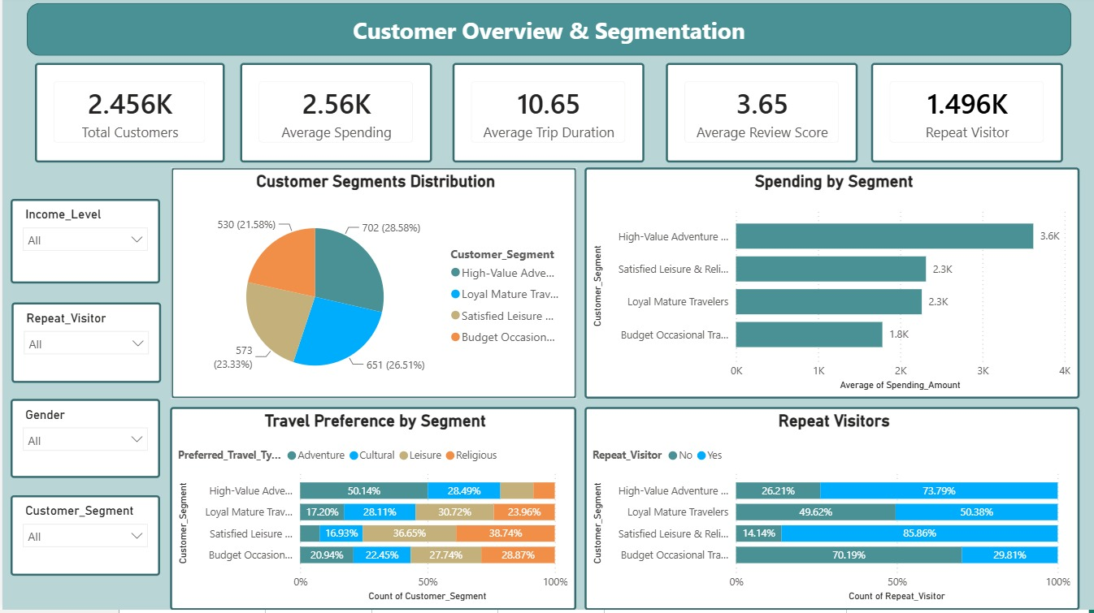
Dashboard — Customer Overview & Segmentation

Slide 17
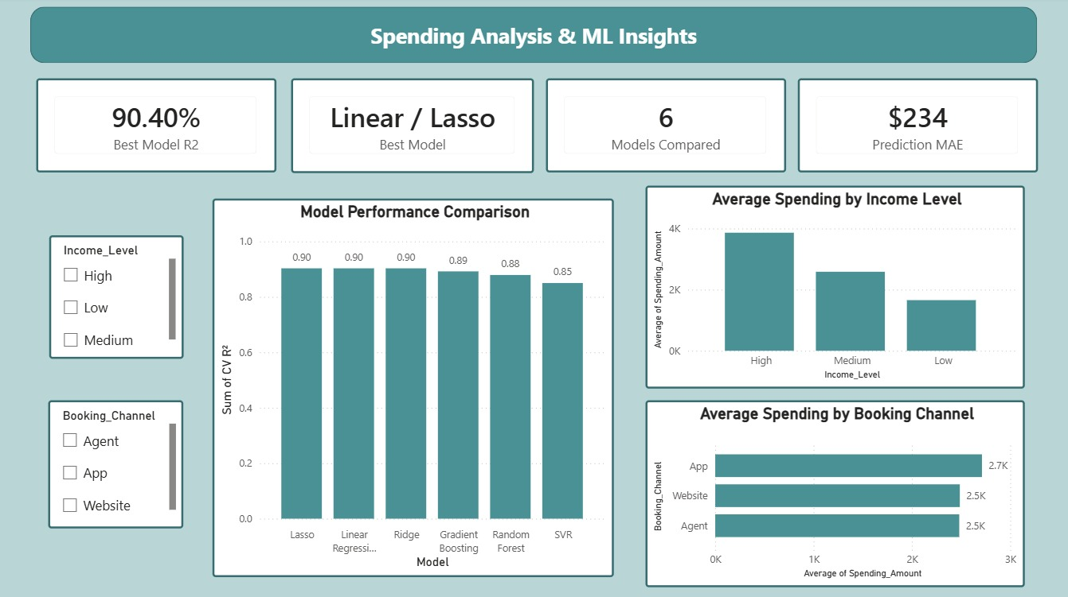
Dashboard — Spending Analysis & ML Insights

Slide 18
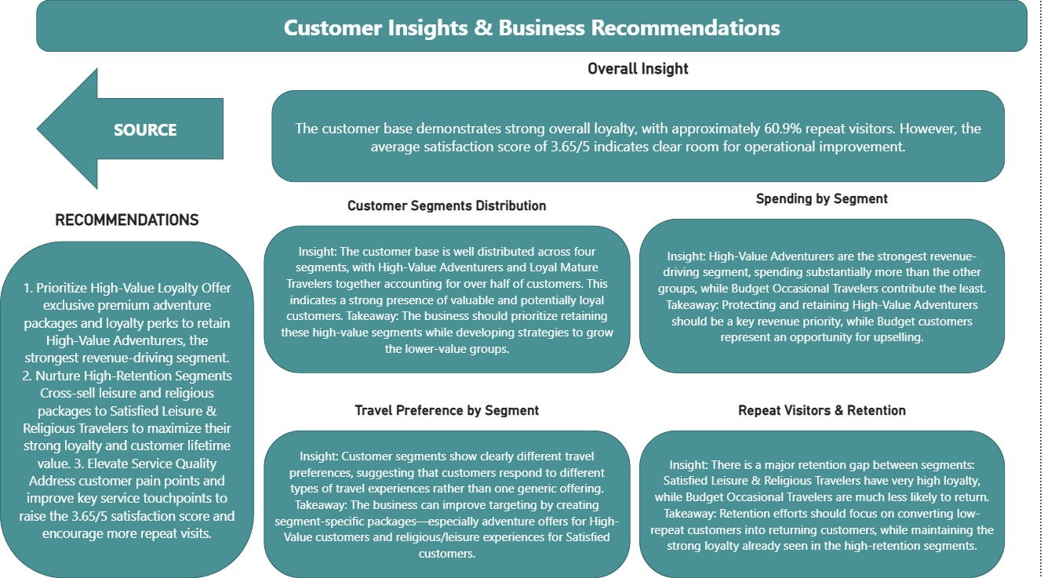
Customer Insights & Business Recommendations

Slide 19
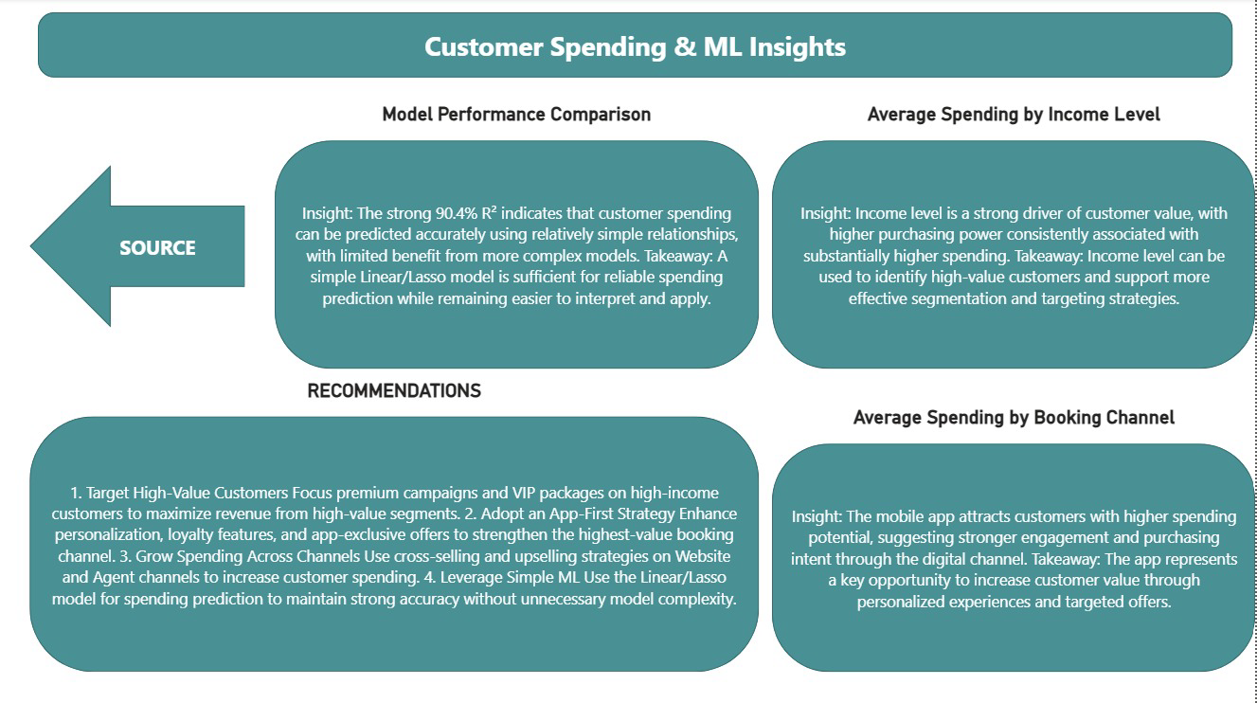
Customer Insights & Business Recommendations

Slide 20
THANK YOU
Questions & Discussion
Tourism Consumer Behavior Analytics — Customer Segmentation & Spending Prediction

